Slide 1
SURF Matching Hardware Architecture

Slide 2
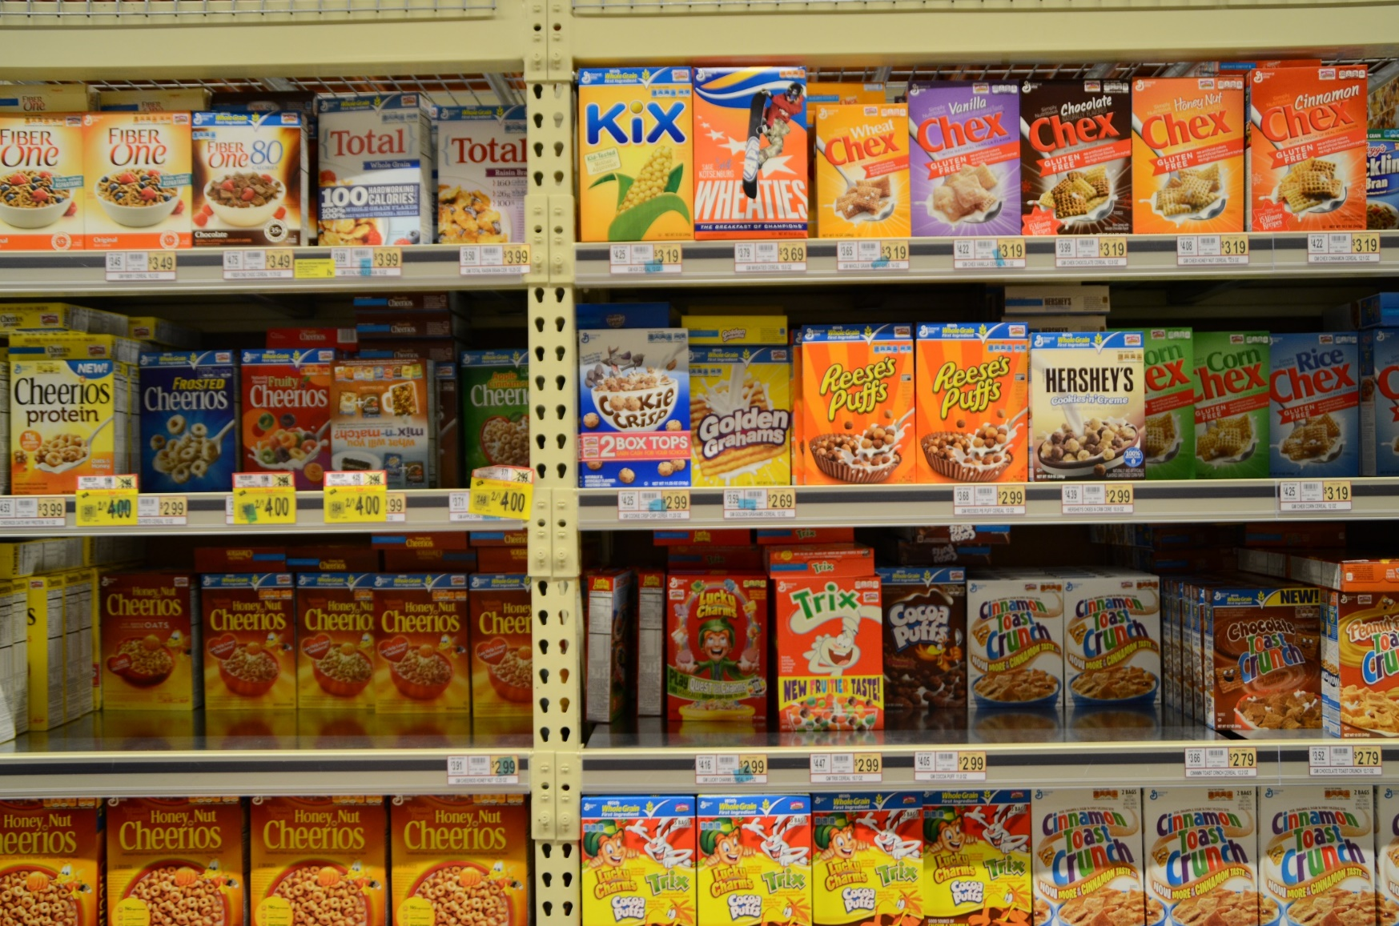
Traditional SURF Algorithm
Notes:
Traditional SURF Matching Algo can become confused because of similar objects close to one another
In addition to other keypoints may confuse the matching processs

Slide 3

Cell Partitioning
CELL
CELL
CELL
CELL
CELL
CELL
CELL
CELL
CELL
CELL
CELL
CELL
CELL
CELL
CELL
CELL
CELL
CELL
CELL
CELL
CELL
CELL
CELL
CELL
CELL
CELL
CELL
CELL
CELL
CELL
CELL
CELL
CELL
CELL
CELL
CELL
CELL
CELL
CELL
CELL
CELL
CELL
CELL
CELL
CELL
CELL
CELL
CELL
Notes:
Extract surf keypoints and bin them based on cell location initially

Slide 4
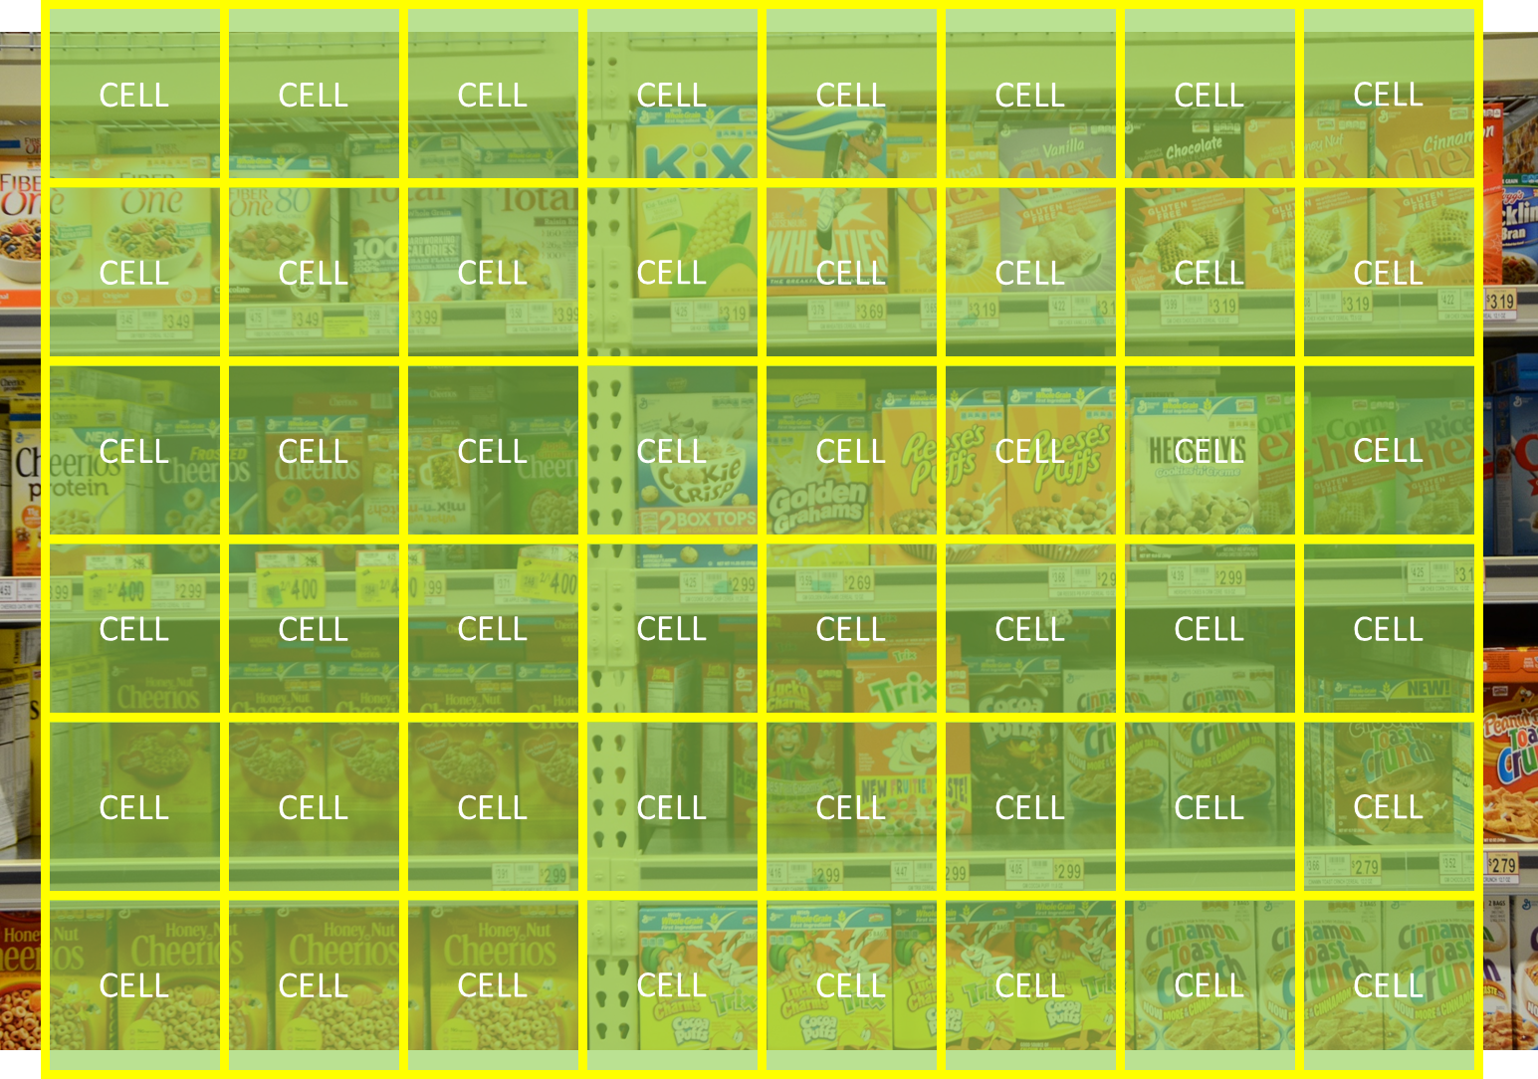
Cell Partitioning (cont.)
 | Best Matched Observed KeyPoint | Distance | 2nd Best Matched Observed KeyPoint | Distance
Model KeyPoint 0 | 3 | 0.124 | 5 | 0.342
Model KeyPoint 1 | 67 | 0.765 | 6 | 0.821
Model KeyPoint 2 | 13 | 0.789 | 7 | 0.923
. . . . . . . .
Modek Keypoint N | 56 | 0.235 | 89 | 0.563
Notes:
Each Cell has its own Match Table

Slide 5
ROI Selection
ROI
ROI
ROI
ROI
ROI
ROI
ROI
ROI
ROI
ROI
ROI
ROI
Notes:
Once we extract the cells we can create ROI’s of varying sizes and score the ROI’s based on likelihood it contains the image we are searching for

Slide 6



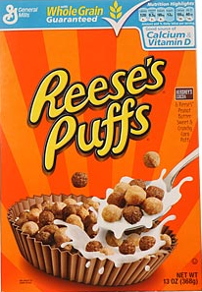
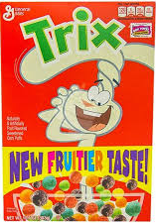
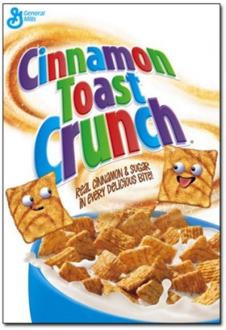
Initial Results

Slide 7
Initial Results

Slide 8
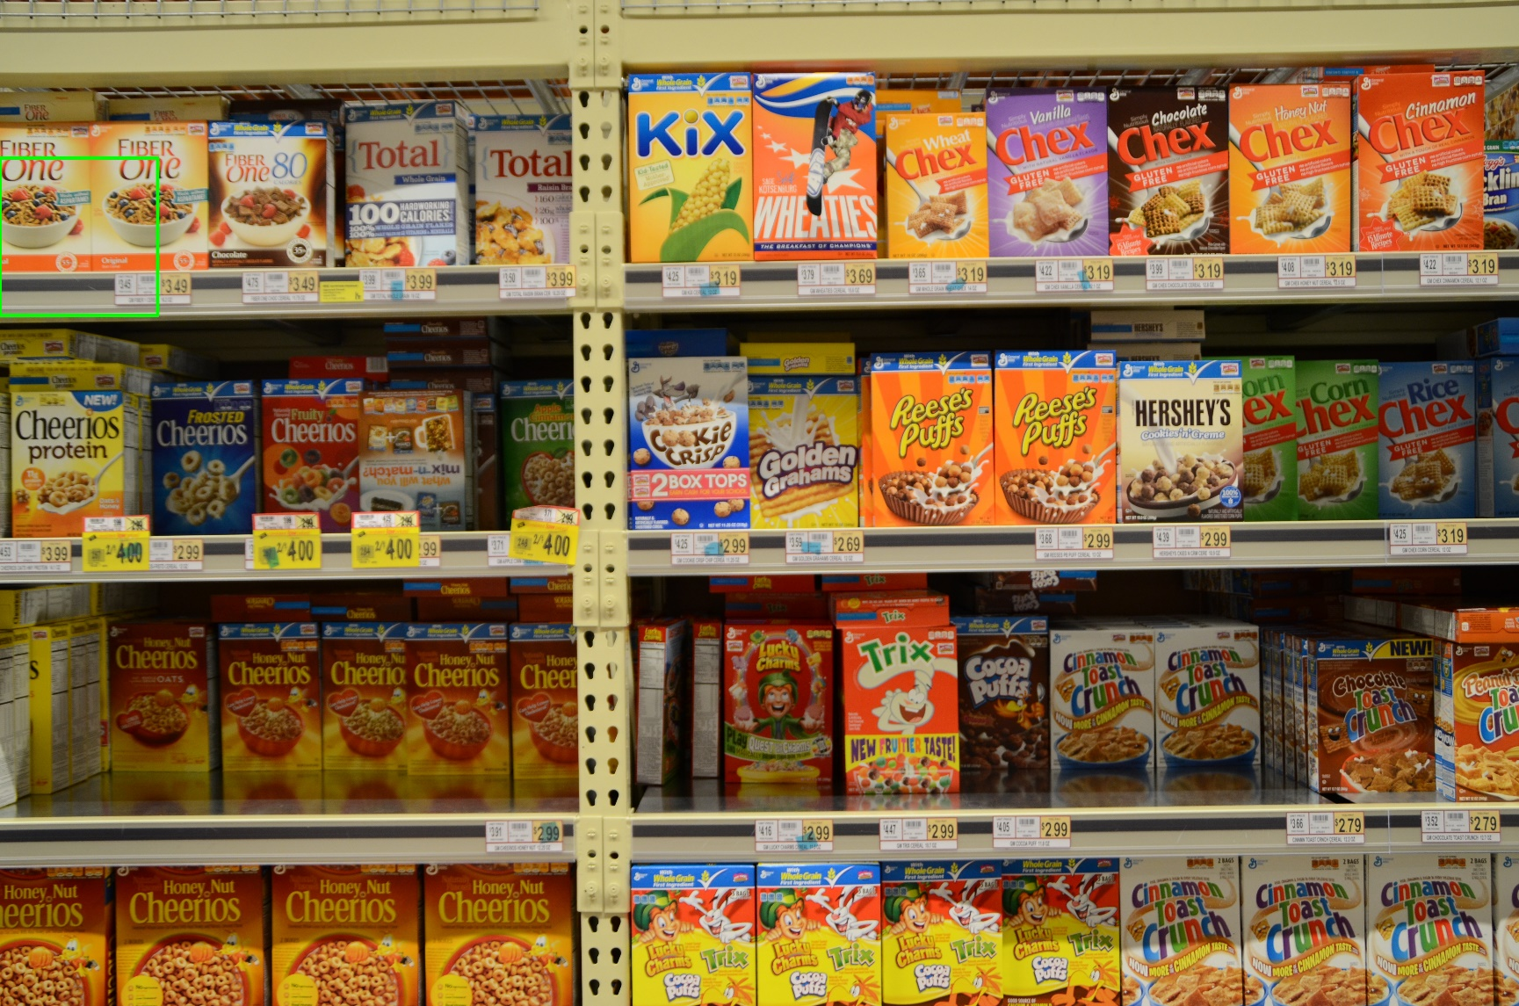
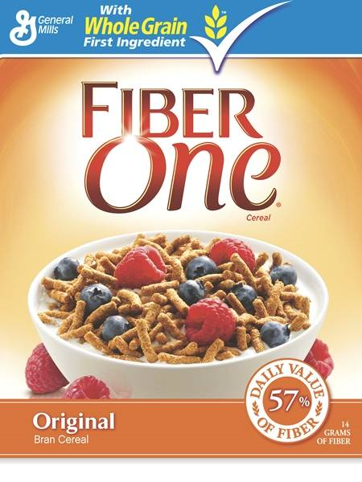
Initial Results

Slide 9
SURF Matching Arch

Slide 10
SURF Matching Arch (cont.)
Notes:
Distribution of keypoint descriptors to compute units

Slide 11
SURF Matching Arch (cont.)
Notes:
Each compute unit comprises of just 1 DSP macro

Slide 12
SURF Matching Arch (cont.)
Notes:
Once a match is computed it is then routed to the correct match table before being retired to host memory

Slide 13
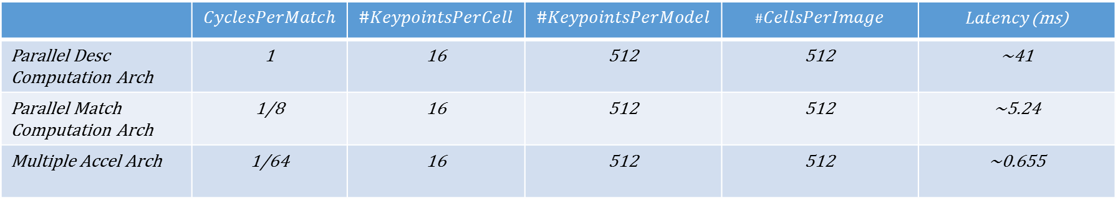
Performance Estimates
$$Latency=\frac{\left(CyclesPerMatch\right)\left(\#KeypointsPerCell\right)\left(\#KeypointsPerModel\right)(\#CellsPerImage) }{ClockFrequency}$$
 | $$CyclesPerMatch$$ | $$\#KeypointsPerCell$$ | $$\#KeypointsPerModel$$ | $$\#CellsPerImage$$ | $Latency$(ms)
Parallel Desc Computation Arch | 1 | 16 | 512 | 512 | ~41
Parallel Match Computation Arch | 1/8 | 16 | 512 | 512 | ~5.24
Multiple Accel Arch | 1/64 | 16 | 512 | 512 | ~0.655

